Slide 1
DLT brand and vehicle type analysis
A proposed decision support project
Measured brand composition and seven independent forecast series
Business Intelligence Term Project
11 October 2026
Group members, topic uniqueness and instructor approval pending
1
Notes:
Sources: supplied DLT raw CSV (SHA256 9fe035b983666fcd021804c5fc1baaff14cd381d5ae1714527cf5ef2ea856f5d), computed verification.json, ModelComparison.csv and HypothesisEvidence.csv. DLT catalog: https://gdcatalog.dlt.go.th/en/dataset/stat_1_1_01_first_regis_vehicles_car. Course requirements: BI_Term_Project_2569.pdf pages 1–2.

Slide 2
Brand and type detail changes the planning question
72.38%
A distributor needs category-specific evidence before translating national registrations into planning assumptions.
Motorcycle share of registrations
in the complete years 2024–2025
Compare brands within vehicle type.
Evaluate forecast error for each segment.
Add inventory, sales and lead times before ordering.
Registration counts are a market-activity proxy. The source contains no transaction prices or inventory.
2
Notes:
Sources: supplied DLT raw CSV (SHA256 9fe035b983666fcd021804c5fc1baaff14cd381d5ae1714527cf5ef2ea856f5d), computed verification.json, ModelComparison.csv and HypothesisEvidence.csv. DLT catalog: https://gdcatalog.dlt.go.th/en/dataset/stat_1_1_01_first_regis_vehicles_car. Course requirements: BI_Term_Project_2569.pdf pages 1–2.

Slide 3
Source coverage and data quality
Check | Measured result
Original snapshot | 68,398 rows and 9 columns
Observed periods | 49 months. December 2023 missing
Partial February 2026 | 6 source records and 18 registrations. Excluded
Missing model names | 623 rows retained for brand/type totals
Exact and natural-key duplicates | 0
Complete modeling period | 25 consecutive months. January 2024–January 2026
Public source: Department of Land Transport. Preserved raw snapshot and SHA256 support repeatable analysis.
3
Notes:
Sources: supplied DLT raw CSV (SHA256 9fe035b983666fcd021804c5fc1baaff14cd381d5ae1714527cf5ef2ea856f5d), computed verification.json, ModelComparison.csv and HypothesisEvidence.csv. DLT catalog: https://gdcatalog.dlt.go.th/en/dataset/stat_1_1_01_first_regis_vehicles_car. Course requirements: BI_Term_Project_2569.pdf pages 1–2.

Slide 4
ETL reconciles source rows and monthly facts
Step | Rows
Original raw data | 68,398
Complete analysis window | 35,805
Date × brand × vehicle type fact | 5,712
Actual registration count | 5,007,659 vehicles
Dimensions | 421 brands and 16 vehicle types
FactRegistrations connects to Date, Brand and VehicleType. A separate Series dimension controls forecasts and model metrics.
4
Notes:
Sources: supplied DLT raw CSV (SHA256 9fe035b983666fcd021804c5fc1baaff14cd381d5ae1714527cf5ef2ea856f5d), computed verification.json, ModelComparison.csv and HypothesisEvidence.csv. DLT catalog: https://gdcatalog.dlt.go.th/en/dataset/stat_1_1_01_first_regis_vehicles_car. Course requirements: BI_Term_Project_2569.pdf pages 1–2.

Slide 5
Six hypotheses have measured outcomes
Hypothesis | Evidence | Outcome
Motorcycles exceed half of registrations | 72.3830% | Supported
Honda is the largest brand overall | 61.7623% share | Supported
Passenger car registrations decline in 2025 | Actual change +3.9995% | Not supported
Three brands exceed 70% of registrations | 81.4304% | Supported
January 2026 exceeds January 2025 | +9.7903% | Supported
Selected total method improves on Naive test MAE | 11.0030% reduction | Supported
Descriptive findings on the supplied snapshot. These results do not establish causation.
5
Notes:
Sources: supplied DLT raw CSV (SHA256 9fe035b983666fcd021804c5fc1baaff14cd381d5ae1714527cf5ef2ea856f5d), computed verification.json, ModelComparison.csv and HypothesisEvidence.csv. DLT catalog: https://gdcatalog.dlt.go.th/en/dataset/stat_1_1_01_first_regis_vehicles_car. Course requirements: BI_Term_Project_2569.pdf pages 1–2.

Slide 6
Honda leads the overall registration mix
Overall brand rankings mix motorcycles and passenger cars. A vehicle-type filter is essential for product decisions.
6
Notes:
Sources: supplied DLT raw CSV (SHA256 9fe035b983666fcd021804c5fc1baaff14cd381d5ae1714527cf5ef2ea856f5d), computed verification.json, ModelComparison.csv and HypothesisEvidence.csv. DLT catalog: https://gdcatalog.dlt.go.th/en/dataset/stat_1_1_01_first_regis_vehicles_car. Course requirements: BI_Term_Project_2569.pdf pages 1–2.

Slide 7
Validation selects the method before test evaluation
Train 12 months
Apr 2024–Mar 2025
Validation 5 months
Apr–Aug 2025
Test 5 months
Sep 2025–Jan 2026
Method | Fixed setup
Linear Regression | Training-only scaling
Ridge Regression | Training-only scaling. Alpha 10
Random Forest | 200 trees. Depth 3. Leaf minimum 2. Seed 42
Gradient Boosting | 200 rounds. Rate .03. Depth 2. Seed 42
Naive baseline | Previous observed month. No model fit
Lag1–Lag3, month sine/cosine and calendar index. Rolling one-month-ahead evaluation. No shuffle.
7
Notes:
Sources: supplied DLT raw CSV (SHA256 9fe035b983666fcd021804c5fc1baaff14cd381d5ae1714527cf5ef2ea856f5d), computed verification.json, ModelComparison.csv and HypothesisEvidence.csv. DLT catalog: https://gdcatalog.dlt.go.th/en/dataset/stat_1_1_01_first_regis_vehicles_car. Course requirements: BI_Term_Project_2569.pdf pages 1–2.

Slide 8
The total method wins validation with MAE 9,436.51
Gradient Boosting remains selected. Random Forest has lower test MAE, which cannot be used to change selection.
8
Notes:
Sources: supplied DLT raw CSV (SHA256 9fe035b983666fcd021804c5fc1baaff14cd381d5ae1714527cf5ef2ea856f5d), computed verification.json, ModelComparison.csv and HypothesisEvidence.csv. DLT catalog: https://gdcatalog.dlt.go.th/en/dataset/stat_1_1_01_first_regis_vehicles_car. Course requirements: BI_Term_Project_2569.pdf pages 1–2.

Slide 9
Each segment retains its validation winner
Series | Method | Test MAE | Test R² | Feb 2026 forecast
Total | Gradient Boosting | 16,207.59 | 0.4257 | 227,934
HONDA | Random Forest | 4,461.94 | 0.5784 | 128,385
TOYOTA | Ridge Regression | 2,331.19 | 0.1598 | 19,006
YAMAHA | Gradient Boosting | 1,255.65 | -0.5593 | 18,789
Motorcycles | Random Forest | 5,760.65 | 0.3158 | 147,213
Passenger cars ≤7 seats | Ridge Regression | 9,857.36 | -0.1553 | 41,274
Private trucks | Naive Forecast | 749.80 | -0.7221 | 6,312
Forecast series overlap. The total already contains the brand and vehicle-type series, so the seven forecasts cannot be added.
9
Notes:
Sources: supplied DLT raw CSV (SHA256 9fe035b983666fcd021804c5fc1baaff14cd381d5ae1714527cf5ef2ea856f5d), computed verification.json, ModelComparison.csv and HypothesisEvidence.csv. DLT catalog: https://gdcatalog.dlt.go.th/en/dataset/stat_1_1_01_first_regis_vehicles_car. Course requirements: BI_Term_Project_2569.pdf pages 1–2.

Slide 10
The January peak creates a large total forecast error
Five held-out months. January error 36,915.32. February forecast 227,934.33 with actual blank.
10
Notes:
Sources: supplied DLT raw CSV (SHA256 9fe035b983666fcd021804c5fc1baaff14cd381d5ae1714527cf5ef2ea856f5d), computed verification.json, ModelComparison.csv and HypothesisEvidence.csv. DLT catalog: https://gdcatalog.dlt.go.th/en/dataset/stat_1_1_01_first_regis_vehicles_car. Course requirements: BI_Term_Project_2569.pdf pages 1–2.

Slide 11
Large errors identify segments needing investigation
Series | Month | Actual | Prediction | Absolute error
Passenger cars ≤7 seats | 2026-01 | 83,281 | 40,445.42 | 42,835.58
Total | 2026-01 | 250,212 | 213,296.68 | 36,915.32
Total | 2025-09 | 188,713 | 169,523.23 | 19,189.77
Total | 2025-12 | 184,093 | 167,494.15 | 16,598.85
Only five test months support these error estimates. Lag/calendar features do not explain the cause of the January jump.
11
Notes:
Sources: supplied DLT raw CSV (SHA256 9fe035b983666fcd021804c5fc1baaff14cd381d5ae1714527cf5ef2ea856f5d), computed verification.json, ModelComparison.csv and HypothesisEvidence.csv. DLT catalog: https://gdcatalog.dlt.go.th/en/dataset/stat_1_1_01_first_regis_vehicles_car. Course requirements: BI_Term_Project_2569.pdf pages 1–2.

Slide 12
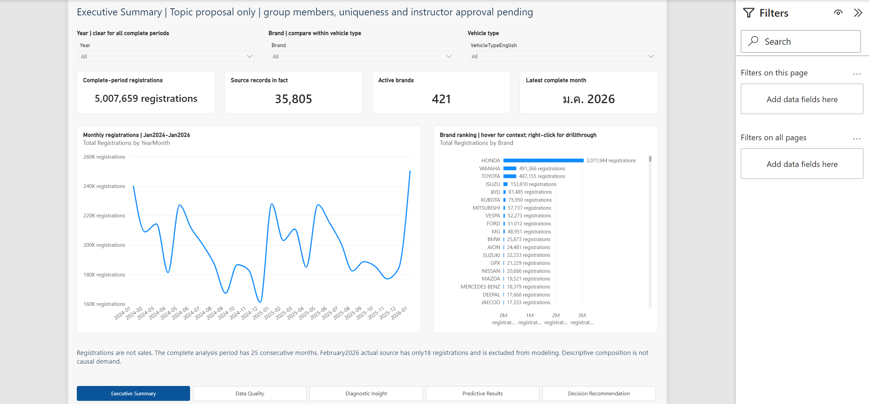
Native Desktop pages and DAX agree with the results
Full refresh and all 7 series pass native DAX. Saved PBIX and user interactions remain pending.
12
Notes:
Sources: supplied DLT raw CSV (SHA256 9fe035b983666fcd021804c5fc1baaff14cd381d5ae1714527cf5ef2ea856f5d), computed verification.json, ModelComparison.csv and HypothesisEvidence.csv. DLT catalog: https://gdcatalog.dlt.go.th/en/dataset/stat_1_1_01_first_regis_vehicles_car. Course requirements: BI_Term_Project_2569.pdf pages 1–2. Actual native Desktop screenshot: BI Term Project/screenshots/Executive Summary.png. Native Full refresh and DAX receipts are copied in native_evidence. Totals and all7series match measured outputs. Direct page captures do not prove user-triggered parameter switching, hover tooltip, drillthrough or Back. Saved PBIX close/reopen and native Word pagination remain pending.

Slide 13
Segment evidence guides planning
Motorcycles dominate overall registrations.
Passenger cars grew 4.00% in 2025.
Forecast reliability differs across segments.
Business use needs inventory, sales, prices and supplier lead times.
More history and rolling validation are needed before stock commitments.
Before submission: actual group identities and topic approval, saved PBIX reopen, real feature interactions and the final demonstration.
13
Notes:
Sources: supplied DLT raw CSV (SHA256 9fe035b983666fcd021804c5fc1baaff14cd381d5ae1714527cf5ef2ea856f5d), computed verification.json, ModelComparison.csv and HypothesisEvidence.csv. DLT catalog: https://gdcatalog.dlt.go.th/en/dataset/stat_1_1_01_first_regis_vehicles_car. Course requirements: BI_Term_Project_2569.pdf pages 1–2.

